Slide 1
Linux Essentials
isecur1ty training center
Presented by : Eng. Mohammad Khreesha

Slide 2
Course contents
Introduction to Linux
Linux installation
Linux commands features and help
Viewing and working with files & directories
Using VI editor
File permissions
Process control
Searching files and directories
Archiving and Compressing files and directories
Remote Login and control
Linux reboot and shutdown

Slide 3
Introduction to Linux
Linux history
Linux components
Linux distribution
Linux installation

Slide 4
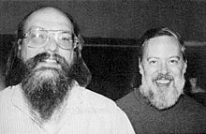
Linux history

Slide 5
Linux components
Kernel
System Library
System Utility
User Interfaces

Slide 6
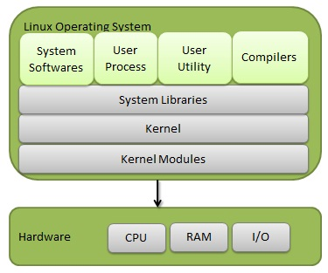
Linux big picture….

Slide 7
Linux Distributions
Red Hat
Ubuntu
Mint
Debian
…….etc

Slide 8
Linux Installation
Lets start ☺

